Slide 1
Connex credit union oNLINE security training
May 12th, 2016

Slide 2
Table of contents
Introductions
Andrew P. Dodd Special Agent FBI
Mohammad Usman Senior Network Engineer Connex Credit Union
Types of attacks
Phishing
Pharming
Vishing
Smishing
Ransomware
Protect Your Computer
Firewall
Antivirus software
Anti-spyware software
Backups
Wireless Network
Public Hot Spots
Electronic Banking
Security Measures
Strong Passwords

Slide 3
Introductions
Andrew P. Dodd

Slide 4
Introductions
Mohammad Usman
Senior Network Engineer
10 years of experience in Information Technology with Connex Credit Union
BS Computer Information Systems
Cisco Certified Network Associate
Microsoft Certified IT Professional (Server 2008 Active Directory)

Slide 5
Phishing - Definition
Phishing refers to criminal activity that attempts to fraudulently obtain sensitive information. There are several ways a fraudster will try to obtain sensitive information such as your social security number, driver's license, credit card information, or bank account information, often luring you with a sense of urgency.

Slide 6
Phishing – Questions to ASk
Do you know the sender of the email? If yes, still be cautious before clicking a link. If no, do not click any links.
Are there any attachments in the email? If so, do not click on the attachment, before contacting the sender to verify its contents.
Does the email request personal information? If so, do not reply.
If you have a relationship with the company, are they addressing you by name?
Have you checked the link? Hover over the link and check the URL. Does it look legitimate or does it look like it will take you to a different Website?

Slide 7
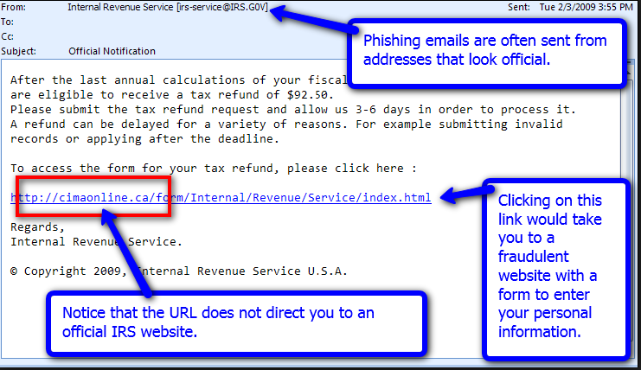
Phishing Attack

Slide 8
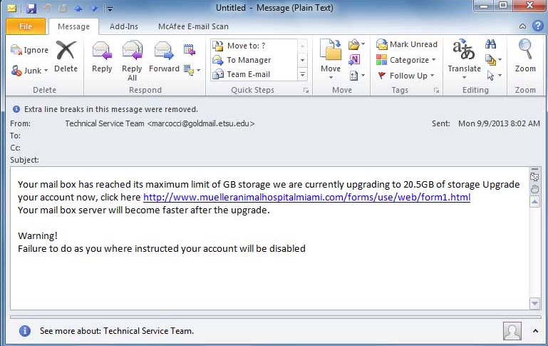
Phishing Attack

Slide 9
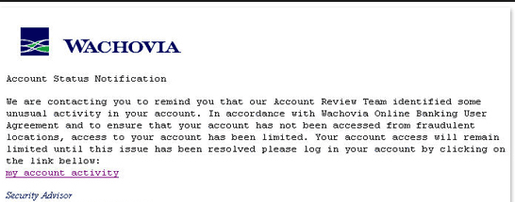
Phishing attack

Slide 10
Pharming - Definition
Pharming is another scam where a fraudster installs malicious code on a personal computer. This code then redirects clicks you make on a Website to another fraudulent Website without your consent or knowledge.
Be careful when entering financial information on a Website. Look for the ‘s’ in https and the key or lock symbol at the bottom of the browser. If the Website looks different than when you last visited, be suspicious and don’t click unless you are absolutely certain the site is safe.

Slide 11
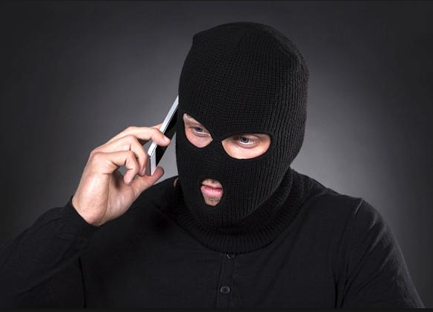
Vishing – Fraud by Phone
Unfortunately, phishing emails are not the only way people can try to steal your personal information to commit fraud. Fraudsters also use the phone to solicit your personal information. This telephone version of phishing is called vishing.
Vishing relies on “social engineering” techniques to trick you into providing information that others can use to access and use your accounts. People can also use this information to pretend to be you and open new accounts.

Slide 12
Smishing – Fraud by Mobile
Just like phishing, smishing uses cell phone text messages to lure consumers in. Often the text will contain a URL or phone number. The phone number may also have an automated voice response system. And again, just like phishing, the smishing message usually asks for your immediate attention.
In many cases, the smishing message will come from a "5000" number instead of displaying an actual phone number. This usually indicates the text message was sent via email to the cell phone, and not sent from another cell phone.
Do not respond to smishing messages.

Slide 13
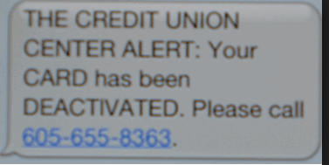
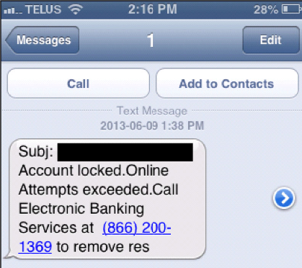
Smishing attack

Slide 14
Ransomware
Ransomware is a malware for “data kidnapping”, an exploit in which the attacker encrypts the victim's data and demands payment for the decryption key.
Ransomware spreads through e-mail attachments, infected programs and compromised websites. A ransomware malware program may also be called a cryptovirus, cryptotrojan or cryptoworm.
Attackers may use several different approaches to extort money from their victims.
Crypto Locker demands payment in Bit Coins and the cost has been known to vary from $500 to $10,000.

Slide 15
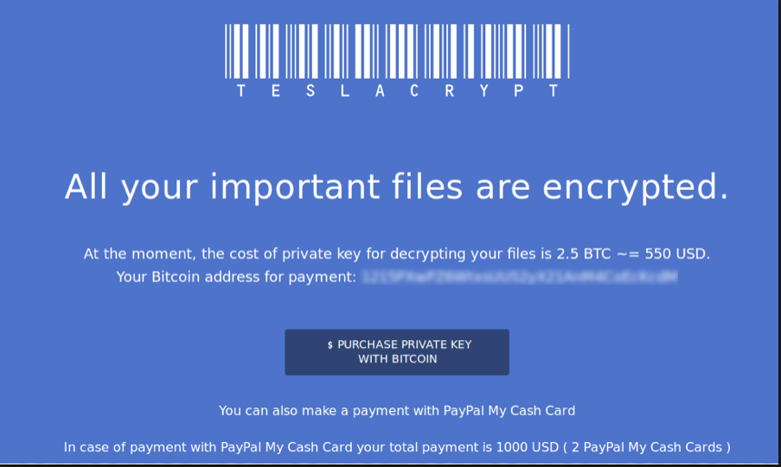
Ransomware

Slide 16
Ransom ware

Slide 17
What can I do??

Slide 18
Protect your computer
Install a Firewall
A firewall is a software program or piece of hardware that blocks fraudsters from entering and using your computer.
Firewalls prevent your computer from responding to these random pings. A firewall blocks communications to and from sources you don't permit.
Enable the firewall on your computer.
Recommend: Big retailers have in-house computer support teams (“Geek Squad”), advise them for what to do

Slide 19
Protect your computer
Antivirus Software
Anti-virus software works to protect your computer from viruses that can destroy your data, slow down or crash your computer, or allow spammers to send e-mail through your account. A properly configured anti-virus program scans your computer and your incoming e-mail for viruses, and deletes them.
Keep your anti-virus software updated!
Make sure your anti-virus software is continually running and checking your system for viruses, especially if you are downloading files from the Web or checking your e-mail.
Set your anti-virus software to check for viruses when you first turn on your computer.
Give your system a thorough scan at least twice a month.
Free Antivirus Software
http://www.avg.com/
https://www.avast.com

Slide 20
Protect your computer
Anti Spyware Software
Spyware is software installed without your knowledge or consent. It can monitor your online activities and collect personal information while you surf the Web. Some kinds of spyware, called keyloggers, record everything you type in – including your passwords and financial information. Your computer may be infected with spyware if you suddenly start receiving pop-up ads. Your computer will begins to run slowly.
Spyware protection is included in some anti-virus software programs.
Don't click on links in pop-up windows or in spam e-mail for “free” anti-spyware offers. Some of these offers are actually designed to install malicious software on your computer.
Free Anti Spyware Software
http://www.avg.com/
https://www.avast.com
https://www.malwarebytes.org

Slide 21
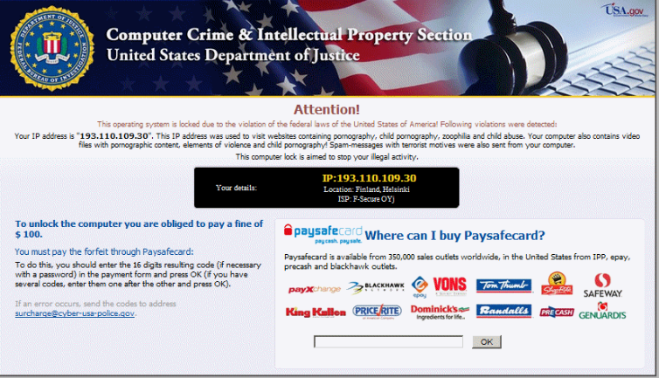
malware - EXAMPLE

Slide 22
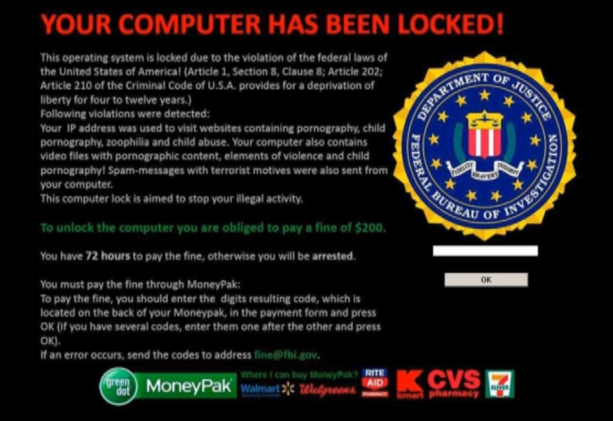
malware – EXAMPLE 2

Slide 23
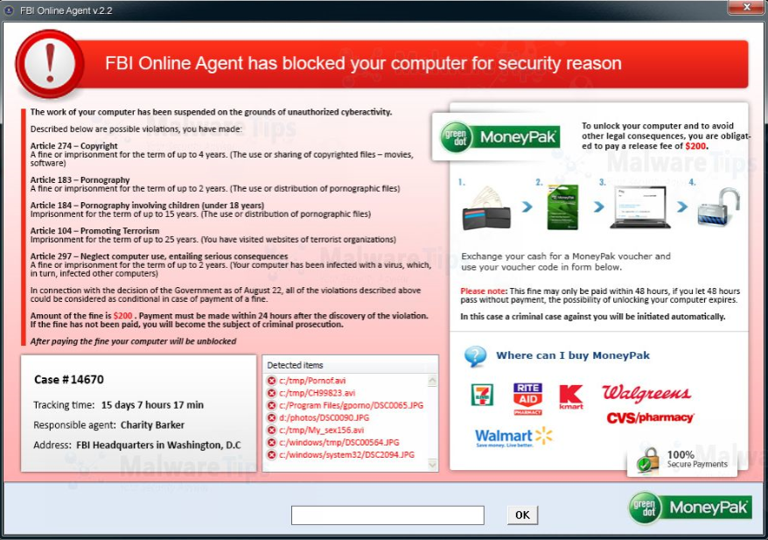
malware – EXAMPLE 3

Slide 24
Protect your computer
Backup Your Data
1. https://drive.google.com
(15 GB of free storage. $1.99/month for 100 GB, and $9.99/month for 1 TB)
2. https://onedrive.live.com
(5 GB of free storage from Microsoft. $1.99 a month for 50 GB a month)
3. https://carbonite.com
(Unlimited cloud storage for 1 computer $59.99 per year)

Slide 25
Protect your computer
Secure your wireless network
Choose a wireless router with an encryption feature and turn it on. WPA encryption is considered stronger than WEP.
Consider disabling identifier broadcasting if your router enables it.
Note the name assigned to your Wi-Fi network. This name – called an SSID, or Service Set IDentifier – lets you connect your computers to the network manually. The SSID is often the equipment maker's name.
Change the SSID on your router and the pre-set administrative password. Fraudsters know the pre-set passwords on many wireless routers.
Recommendation: Make sure your wireless network has a password on it
http://www.av

Slide 26
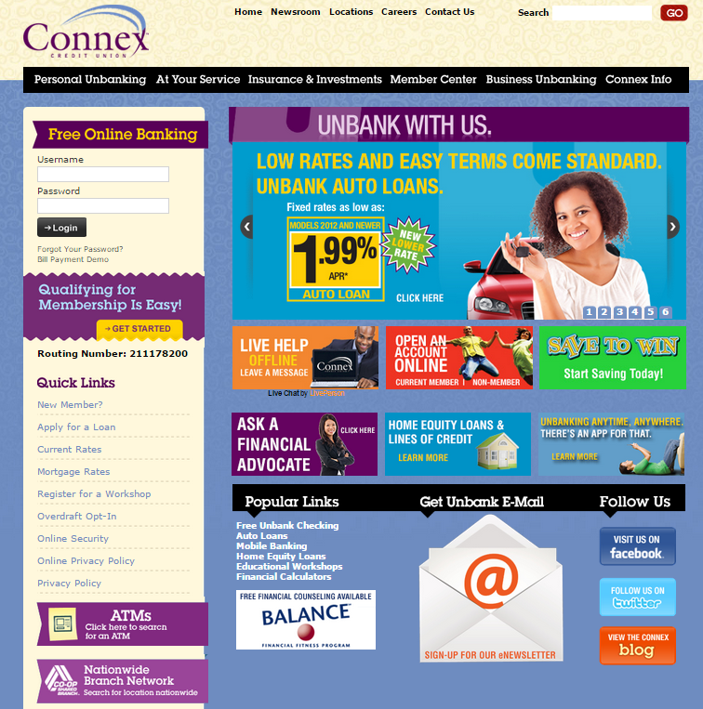
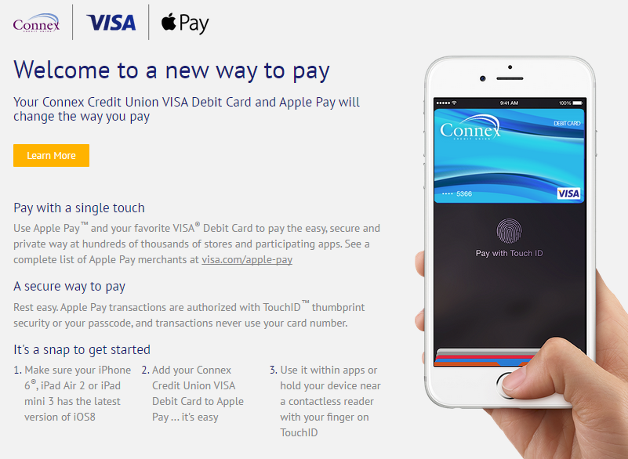
Electronic Banking
Members can securely access Connex through our electronic channels:
Internet Banking
Mobile Banking Application
Remote Deposit
https://www.connexcu.org

Slide 27
Secure Ways to Bank
Online & Mobile Banking
Transfer money
Bill Pay
eStatements
PopMoney (pay money to other people)
Deposit a check by taking a picture of it (Mobile Deposit)
FinanceWorks
Biometrics (Touch ID)
Mobile Payments
Apple Pay
Android Pay
Samsung Pay
PopMoney

Slide 28
Security With COnnex
Access Connex securely through our electronic channels:
Setup a username and password.
Create options for Multi-Factor Authentication by entering a Home Phone, Cell phone and email address. These options are used to send One-Time use access codes as an added security measure.
Connex doesn’t use security questions anymore. Due to the presence of social media, many answers to typical questions can be found by researching consumers on their social media pages.
In 2015, Connex also introduced the use of Bio-Metrics for login validation. Touch ID is currently available on iOS devices (iPhone 5s and newer). Will be available for use with Android devices late 2016
https://www.connexcu.org

Slide 29
Electronic Banking
Other ways you can protect your account
Do not save your usernames and passwords in your browser.
Set-up Alerts and Notifications on your account.
You can set-up transactions alerts and notifications based on certain dollar amounts.
Quick Balance functionality is also available in the Mobile Banking Application. (Swipe down from top of the screen)
Can view the last few transactions that have posted on your account without logging into the application. **Must be completed on a previously identified device
https://www.connexcu.org

